Slide 1
OpenAPI 2 vs. OpenAPI 3

Slide 2
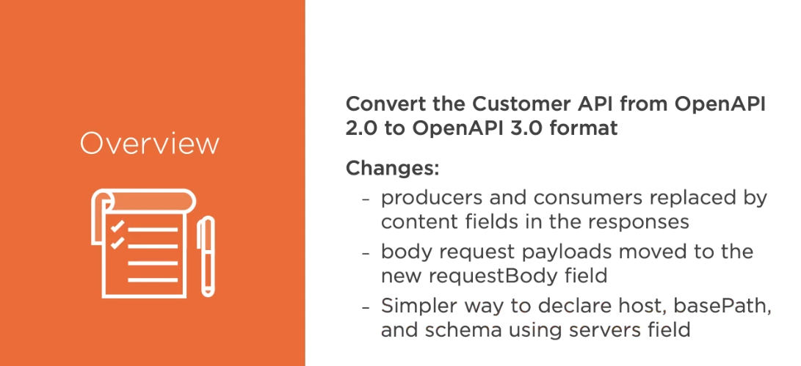

Slide 3
The Content and RequestBody Fields

Slide 4
Servers, Security and Components

Slide 5

OpenAPI 2 remains in wide use today
OpenAPI 3 is growing in popularity OpenAPI 3: more flexible and organized Swagger Editor: OpenAPI 2 -> 3 Changes:
Summary
Version has changed from swagger:‘2.0’ to openapi:‘3.0.2’
info filed is unchanged
content field replaces consumes and produces
servers field replaces host, basePath, and schema for URLs
components field replaces definitions

